Slide 1




Slide 2
Family Resource Coordinator
“A Family Resource Coordinator- provides valuable community resources to our employee population. Ensuring that employees have access to area businesses that provide childcare, housing and other services at a discounted rate. Directing employees to the correct HR departments to assist with their individual questions or needs.”

Slide 3
GatorPerks
Exclusive discounts for UF employees
  Shopping & Services (Childcare & Nanny, Beauty, Pets and Retail)
  House and Home (Real Estate and Apartment rental, painting and lawn care and many others)
  Health and Wellness (Salt Rooms, Personal Training, Fitness Clubs)
  Transportation (Car Rental, Car Sales, Services and Repairs)
  Travel & Entertainment (Hotels, Travel and Entertainment)
  UF Campus Discounts (Medical, Museum, press book order, Rec Sports)
  Food and Restaurants ( local meal kits and restaurants)
  Art and Leisure (Farms, Art, theatre, Zoo & Music and Dance)

Slide 4
On Campus Resources
Field and Fork Pantry- https://pantry.fieldandfork.ufl.edu/
Lactation rooms- https://campusmap.ufl.edu/#/index
Counseling and Wellness Center (CWC)- http://www.counseling.ufl.edu/cwc/
Criss and Emergency Resource Center (CERC)- http://www.counseling.ufl.edu/services/crisis/
Employee Assistance Program ( UF EAP)- https://eap.ufl.edu/
Aid-A-Gator- https://benefits.hr.ufl.edu/gatorperks/aid-a-gator/

Slide 5
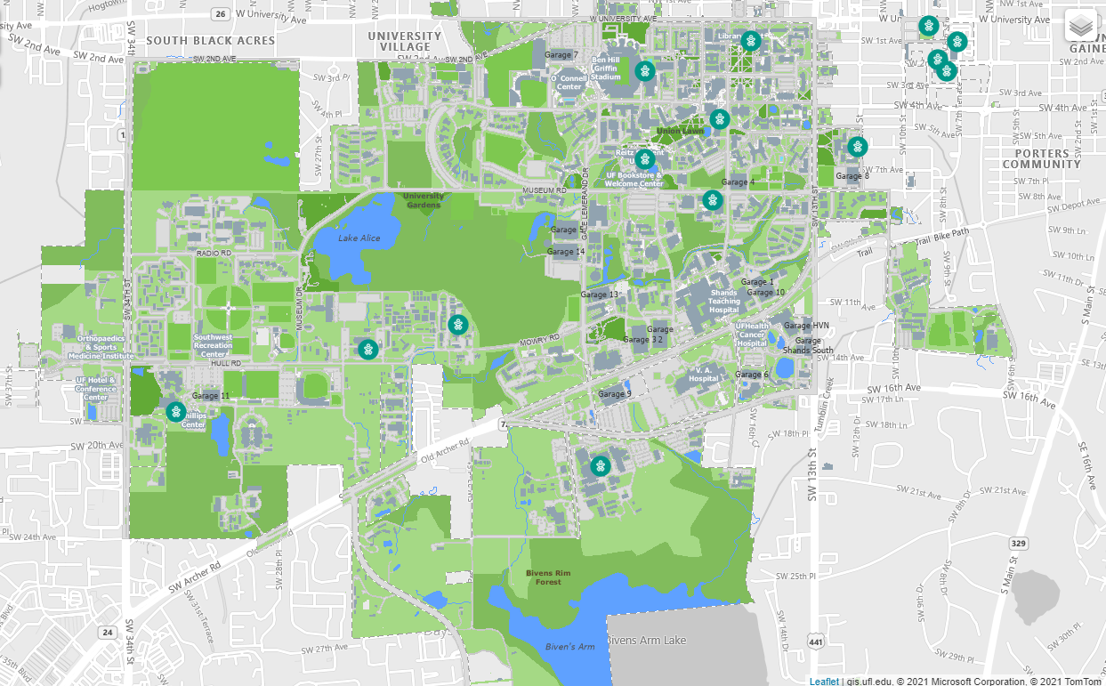
On Campus Lactation Rooms

Slide 6
Contact:
Alisha Hargon, Family Resource Coordinator
FamilyResources@hr.ufl.edu

